Slide 1
Round Robin SCHEDULING
Group-06

Slide 2
Introduction
Round-robin CPU scheduling is a popular algorithm used in operating systems to manage the execution of processes. It is a preemptive scheduling algorithm that assigns a fixed time slice, known as a time quantum, to each process in a circular queue. The algorithm ensures fairness by giving each process an equal amount of CPU time, allowing for efficient sharing of system resources. With its emphasis on fairness and responsiveness, round-robin scheduling plays a crucial role in achieving efficient CPU utilization and maintaining system performance in modern operating systems.

Slide 3
How Round Robin Works
All the processes are added to the ready queue.
At first, The burst time of every process is compared to the time quantum of the CPU.
If the burst time of the process is less than or equal to the time quantum in the round-robin scheduling algorithm, the process is executed to its burst time.
If the burst time of the process is greater than the time quantum, the process is executed up to the time quantum (TQ).
When the time quantum expires, it checks if the process is executed completely or not.
On completion, the process terminates. Else, it goes back again to the ready state.

Slide 4
Small example
Process ID | BT | CT | TAT | WT
P1 | 21 | 32 | 32 | 11
P2 | 3 | 8 | 8 | 5
P3 | 6 | 21 | 21 | 15
P4 | 2 | 15 | 15 | 13

Slide 5
Advantages
Fairness.
Responsiveness.
Simple Implementation.
Preemption.

Slide 6
Disadvantages
Poor Performance for Long-Running Processes.
High Context Switching Overhead.
Inefficient CPU Utilization.
Not Optimized for Priorities.

Slide 7
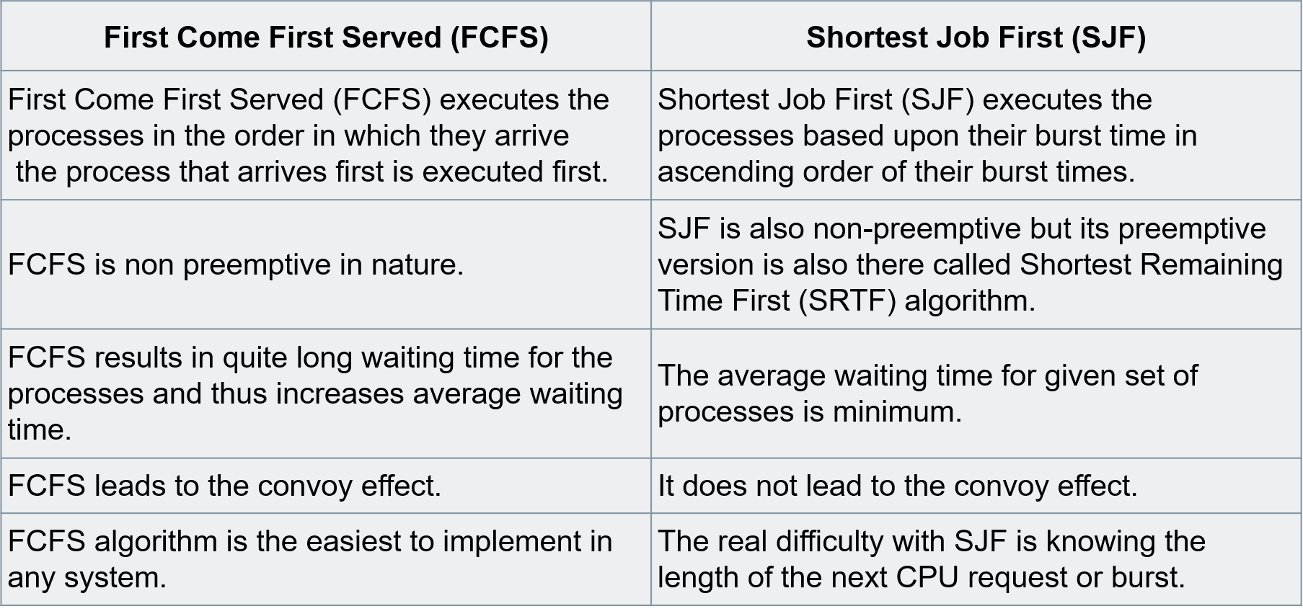
First Come First Served(FCFS)

Slide 8
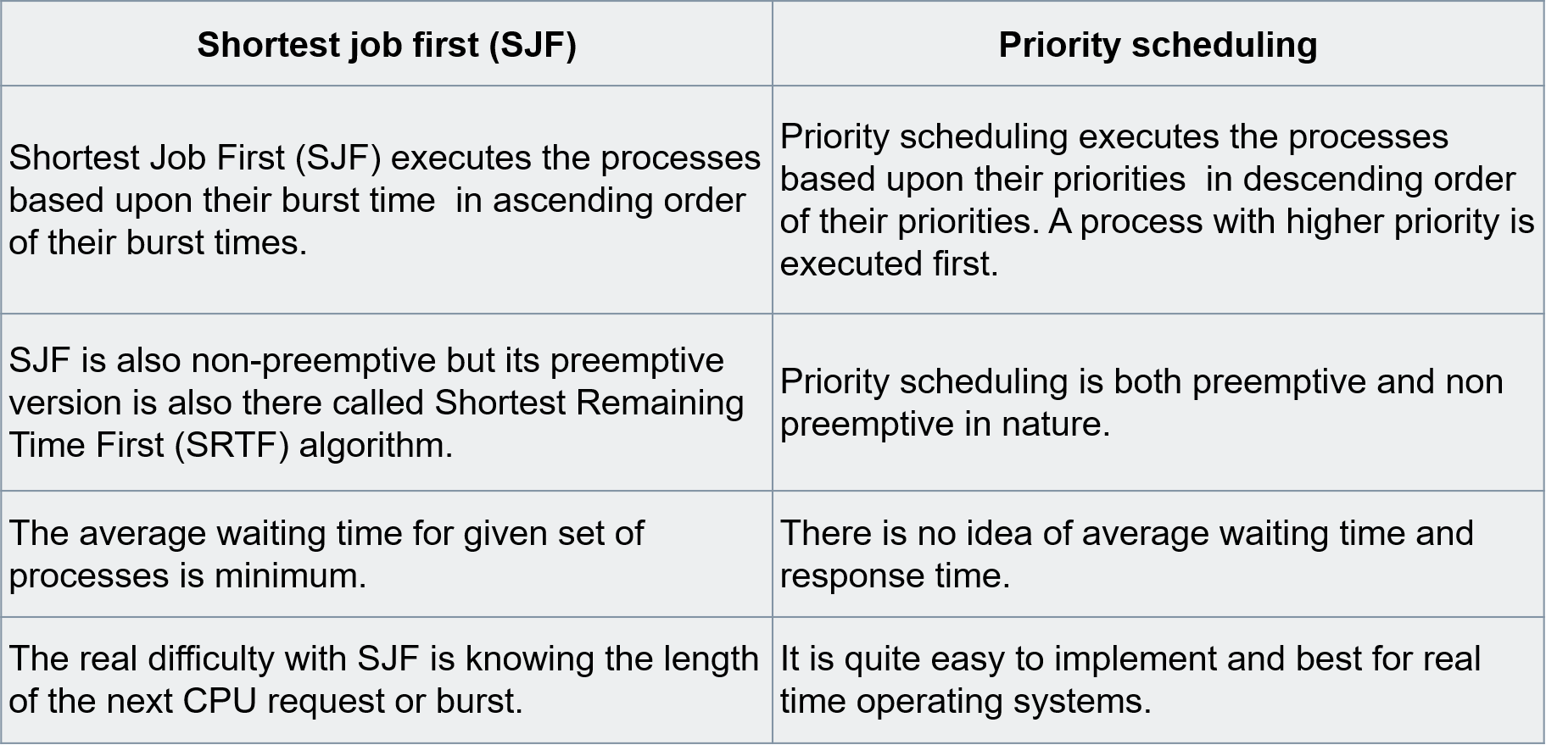
First Come First Served(FCFS)

Slide 9
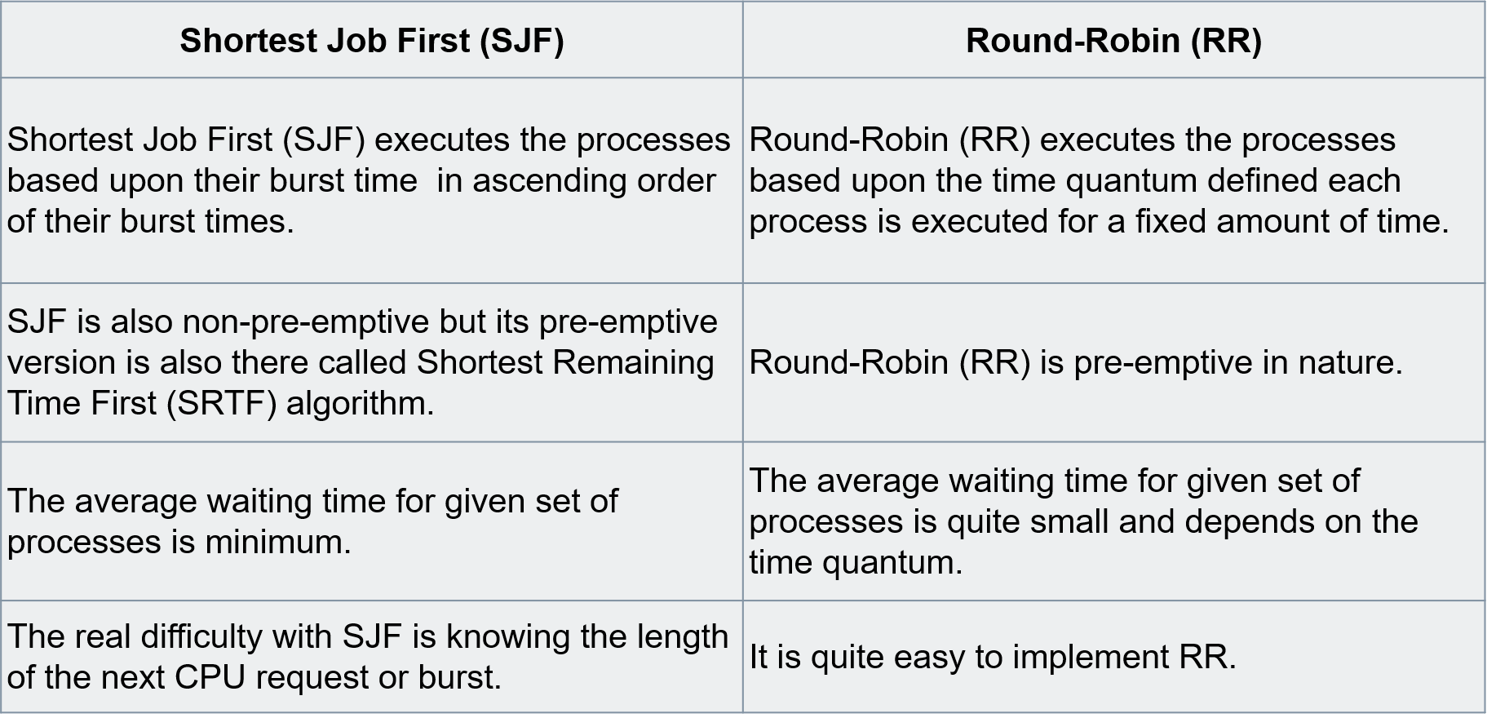
First Come First Served(FCFS)

Slide 10
Group Members
EUSL/TC/IS/2019/COM/63
EUSL/TC/IS/2019/COM/25
EUSL/TC/IS/2019/COM/35
EUSL/TC/IS/2019/COM/40
EUSL/TC/IS/2019/COM/53
EUSL/TC/IS/2019/COM/92
EUSL/TC/IS/2019/COM/109

Slide 11
THANK YOU!

